Slide 1
F1nance ER Diagram

Slide 2
F1nance List Of Entities
Entity Name | Entity Primary Attributes
Users | UserId, Name, Email, Visa Status, Education Details
Bank Account | UserId, BankAccountId, Bank Name, Account Number, Linked Date
Transaction | UserId, BankAccountId, TransactionId, Amount, Date, Category
Document | UserId, DocumentId, Document Type, File Name, Upload Date
Notification | UserId, NotificationId, Type, Message, Due Date
Subscription | UserId, SubscriptionId, Plan, Status, Start Date, End Date
Compliance Policy | PolicyId, Name, Effective Date, Description
TaxForm | TaxformId, UserId, FormType, Taxyear
Currency Trace | TraceId, UserId, CurrencyCode, Amount, ConvertedAmount, Rate, TraceDate
Engagement | EngagementId, UserId, LessonId, LastAccessed, TotalTimeSpent
Report | ReportId, UserId, ReportType, GeneratedDate, FilePath, Status
User Request | RequestId, UserId, Category, Message, Status, CreatedDate, ResolvedDate
Payment | PaymentId, UserId, SubscriptionId, Amount, PaymentMethod, PaymentDate, PaymentStatus
Financial Literacy Lesson | LessonId, Title, Topic, ResourcePath, Description, Content

Slide 3
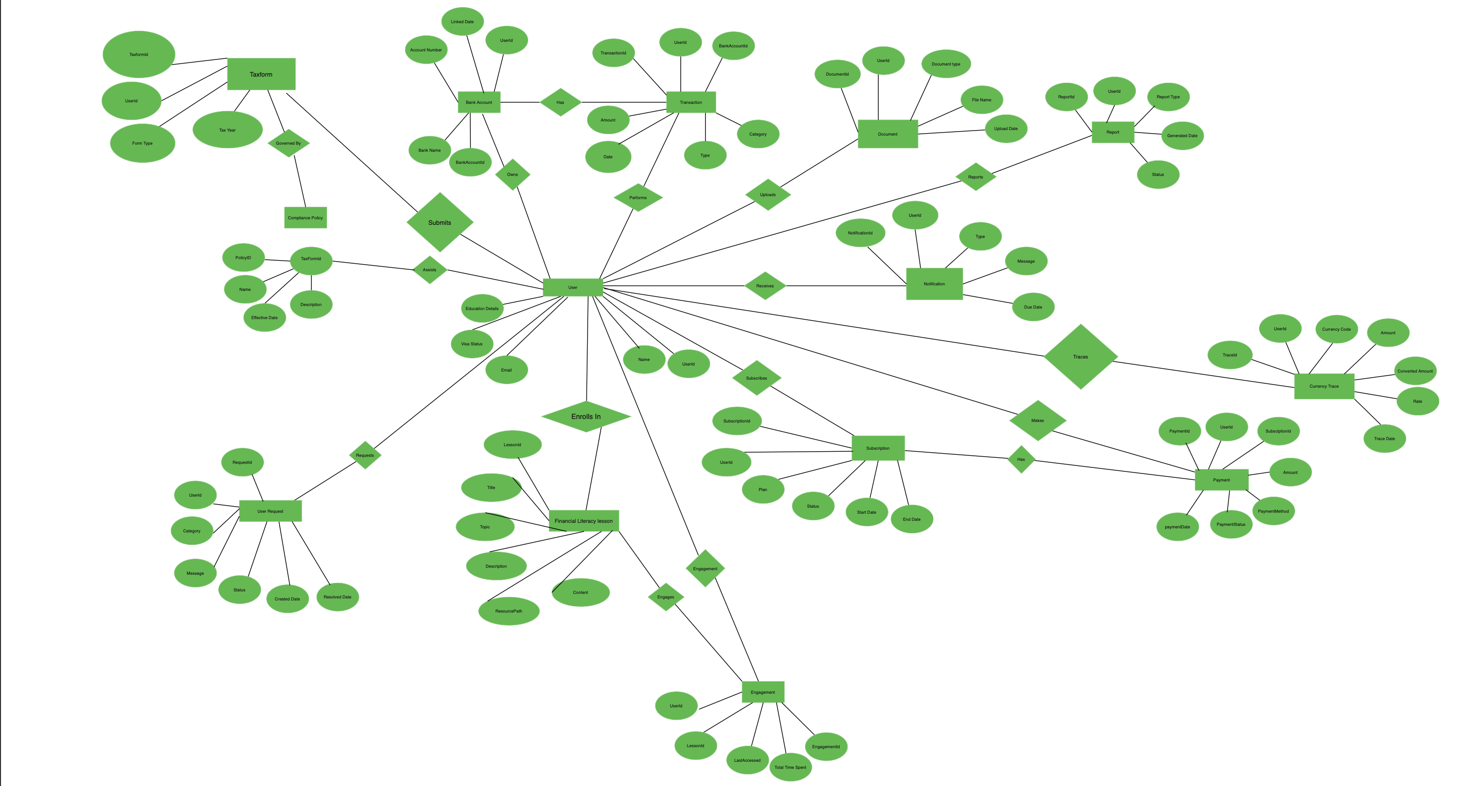
F1nance Conceptual ER Diagram

Slide 4
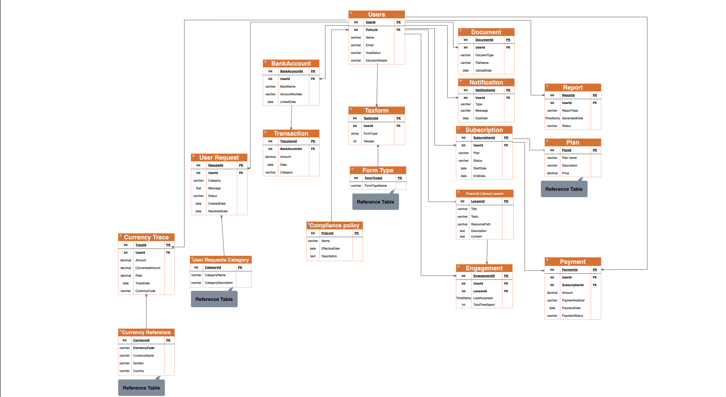
F1nance Logical ER Diagram

